Slide 1
Perspectives for the Energy Transition
Investment Needs for a Low-Carbon Energy System
Dolf Gielen
International Renewable Energy Agency

Slide 2
This presentation
What does the global energy mix look like today? What would it look like 2050 in order to keep global temperature rise below 2 degrees?
How can the energy sector achieve a transition to a decarbonised, reliable and secure energy sector at reasonable costs? What are key policies and measures?
What is the role of more stringent regulations, better market design and/or higher carbon prices for the energy sector transition?
What are the co-benefits for other energy policy objectives that could result from an energy sector transformation?
What are the investment needs associated with the energy sector transition and how do investment patterns need to change to reach a low-carbon energy system? Which parts of the energy system will require most investments? What does this mean for emerging economies?
In case of a timely low carbon energy transition, what is the outlook for stranded assets? What is the impact for stranded assets if action is delayed and the transition is sharper?

Slide 3
How is energy used today ?
Primary Supply
Total Final Consumption
395 EJ
395 EJ
574 EJ
574 EJ
14.2% Renewables
18.3% Renewables
Source: IEA
130 EJ conversion losses / own consumption electricity sector
Final Consumption 1/3 Buildings, 1/3 Transport, 1/3 Industry
Around 65 EJ renewable energy in TFEC (incl renewable electricity)

Slide 4
Trends
RE share on Total Final Energy Consumption (TFEC) is rising by 0.17%/yr (2010-2015)
Energy intensity of global GDP is falling by 1.8%/yr (2010-2015)
Energy CO2 emissions were constant last couple of years
Rapid technological change across energy supply and demand

Slide 5
On-going global power sector transformation
GW
Share of renewables in total capacity additions
Since 2012 >50% of total capacity additions
2016
Installed 2006 GW RE power generation capacity
Annual RE capacity addition 161 GW
of which:
71 GW solar
51 GW wind
30 GW hydropower
9 GW biomass
Around 25% RE power generation share worldwide; growing by 0.7 percentage points per year

Slide 6
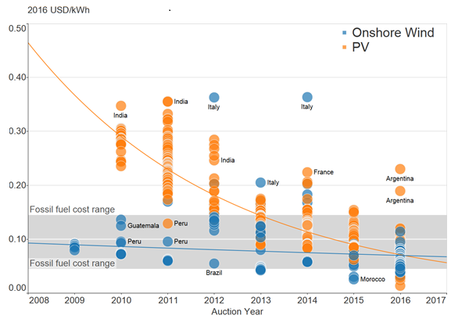
Attractive economics - auction and PPA price trends
Convergence of solar PV and onshore wind prices
Project “boundaries” differ and affect the price
Projects for a wide range of technologies and locations are being offered at very low long-term contract prices
Best practice:
Concentrating Solar Power CSP @ 9.5 UScents/kWh (Dubai), 7 UScents/kWh (South Australia)
Solar PV @ 2.4 -3 UScents/kWh (Mexico, Abu Dhabi) – latest German Auction <6 US cents/kWh
Onshore wind @ 3 UScents/kWh (Morocco, Mexico)
Offshore wind @ <7 UScents/kWh (NW Europe)

Slide 7
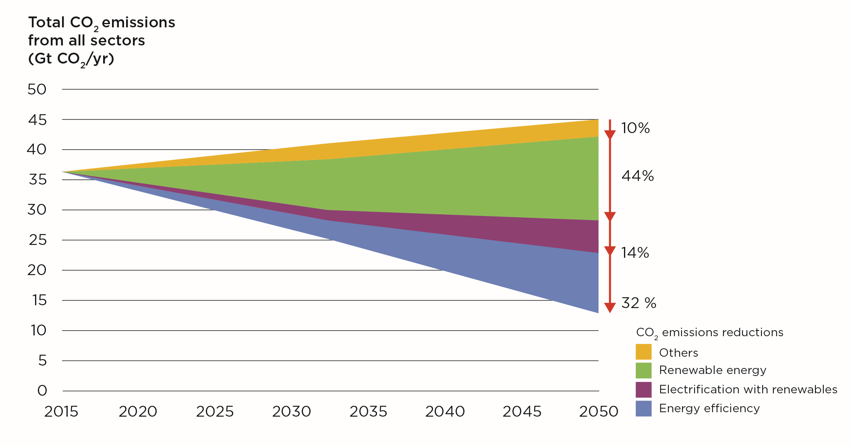
Energy & non-energy CO₂ emission reduction potential by technology
Energy & process & NEU emissions excl. LULUCF
Renewables would account for half of total emission reductions in 2050, with another 45% coming from increased energy efficiency and electrification.

Slide 8
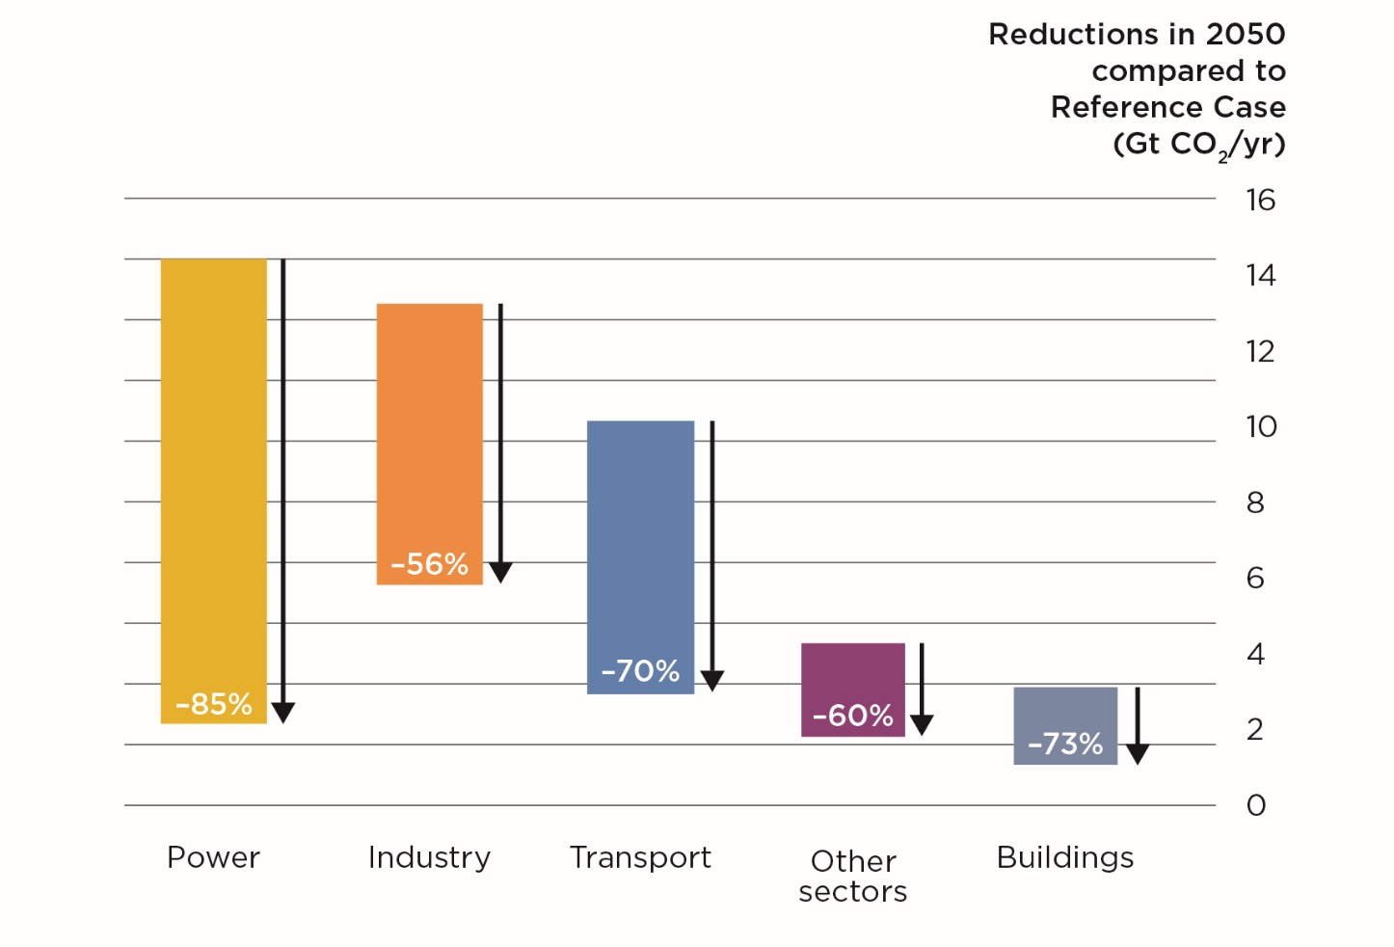
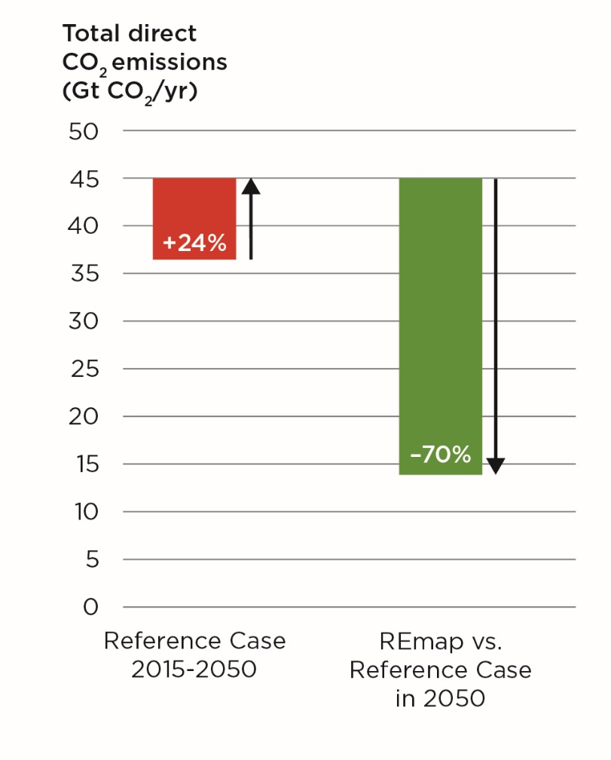
CO₂ emissions by sector in REmap relative to the Reference Case
By 2050, total energy-related CO₂ emissions will need to decrease to below 10 Gt.
CO₂ emissions from the power and buildings sectors will be almost eliminated.
Industry and transport would be the main sources of emissions in 2050.

Slide 9
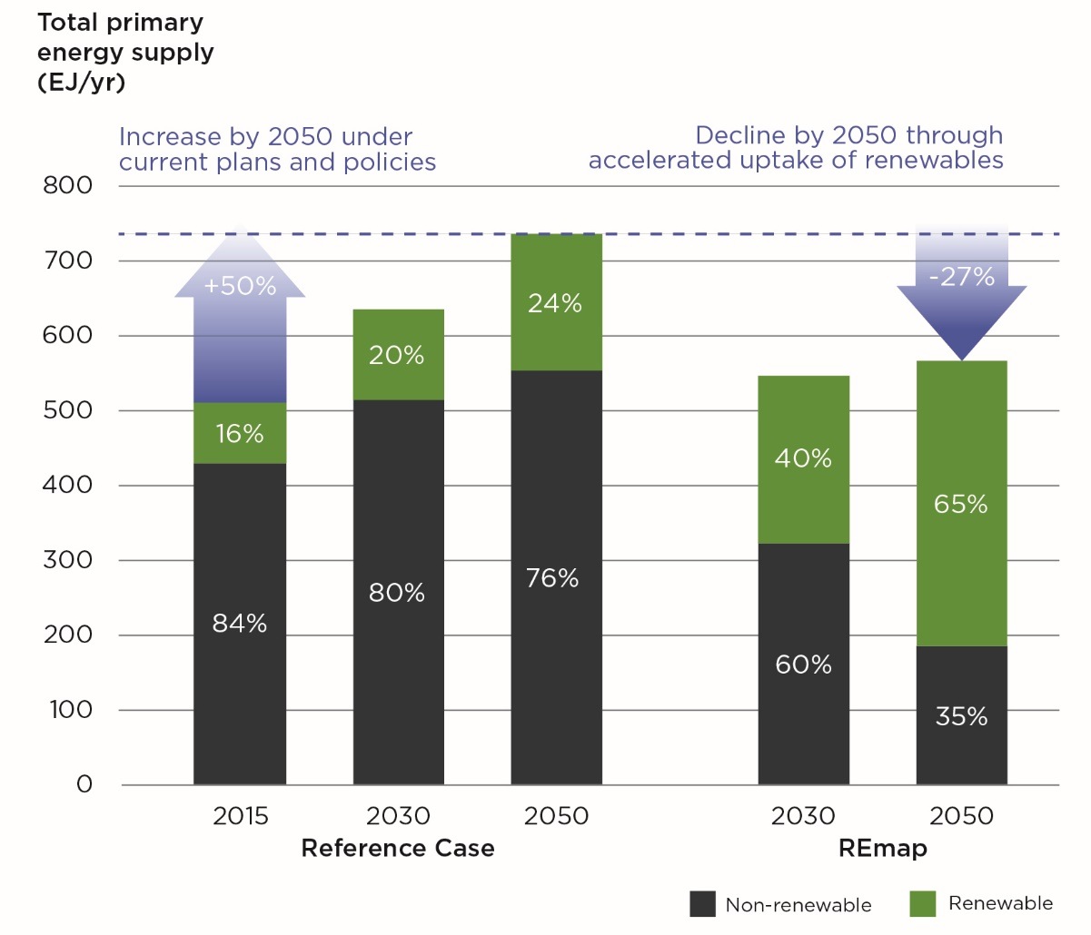
Breakdown of total global primary energy supply
  Renewable energy would be the largest source of energy supply under REmap in 2050, representing two-thirds of the energy mix.
  This requires an increase in the renewables’ share of about 1.2% per year, an eight-fold acceleration compared to recent years.
  Energy intensity improved at an annual rate of about 1.8% in recent years and is expected to be maintained in the Reference Case, while it would increase to around 2.5% per year in REmap.

Slide 10
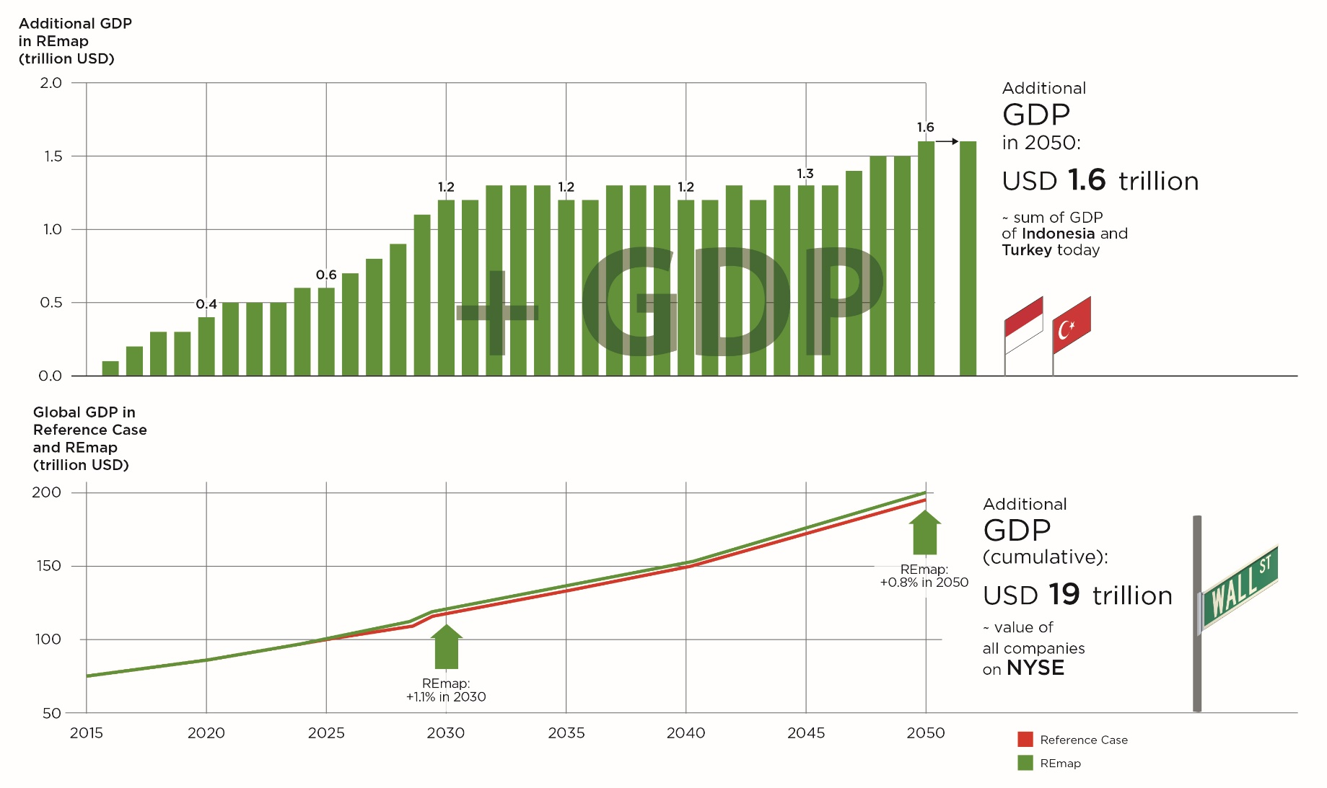
Global GDP impacts of the REmap energy transition:
additional and absolute GDP values
Decarbonising the energy sector in line with REmap increases global GDP by around 0.8% by 2050 compared to the Reference Case (investment growth early on creates a multiplier effect).
In cumulative terms this constitutes almost USD 19 trillion in increased economic activity between today and 2050.

Slide 11
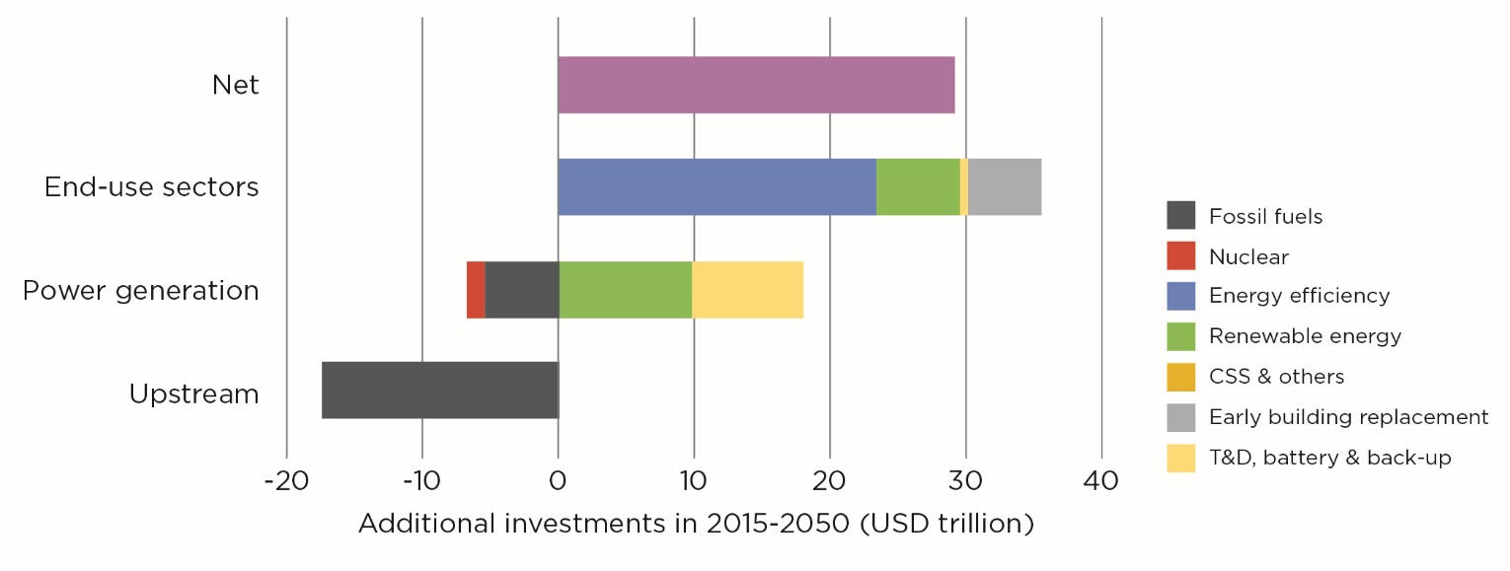
Additional investment needs by sector and technology in REmap
relative to the Reference Case
Meeting the 2ºC target requires investing an additional USD 29 trillion between 2015 and 2050 compared to the Reference Case (equal to 0.4% of cumulative GDP).
The largest additional investment needs are in energy efficiency, followed by renewables.
The total investment cost, however, is reduced by the avoided investments in the upstream sector and in fossil-fuelled power generation.

Slide 12
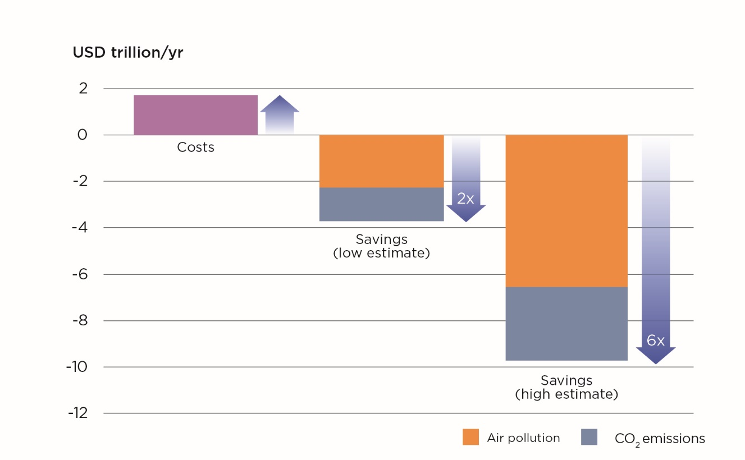
Costs and reduced externalities of decarbonisation – important health benefits
Benefits from reduced externalities exceed the costs of decarbonisation by a factor between two and six in 2050.
Health benefits from reduced air pollution health alone exceed the costs.

Slide 13
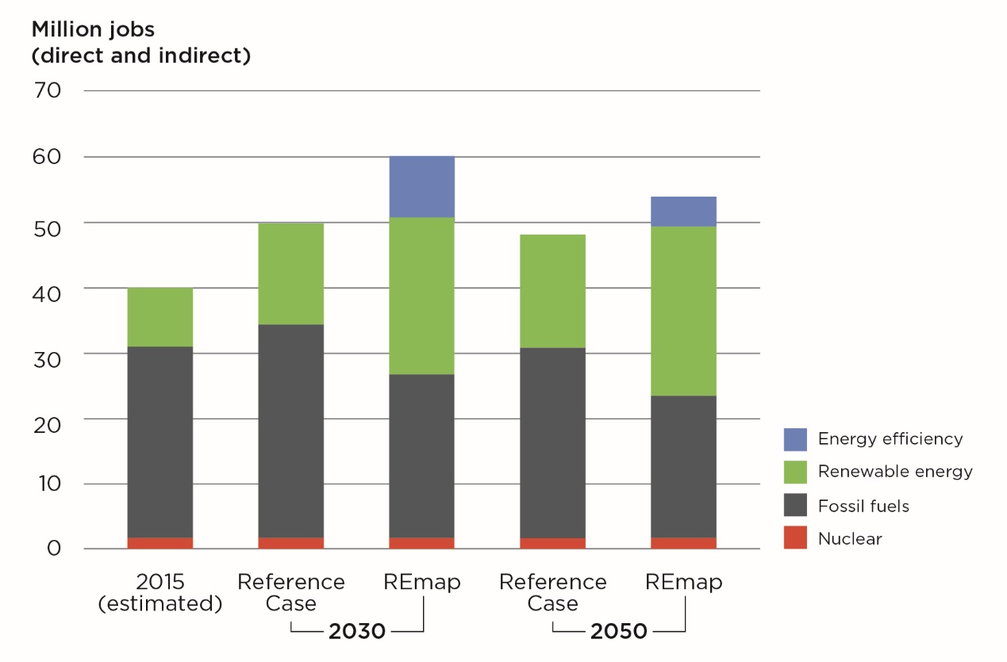
Energy transition results in jobs growth
New jobs in renewables and energy efficiency more than offset job losses in fossil fuel sectors.

Slide 14
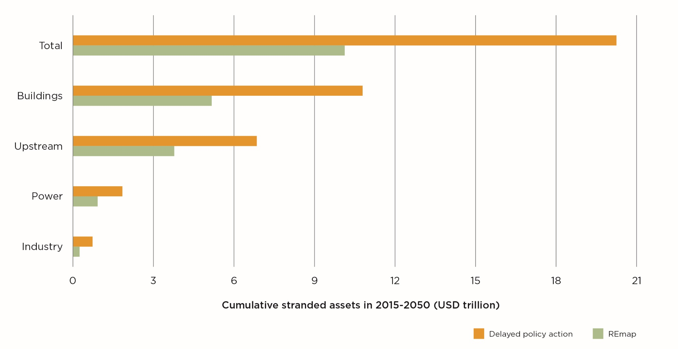
Stranded assets by sector in REmap and Delayed Action cases
Delaying action will result in double the amount of stranded assets: from USD 10 trillion to USD 20 trillion.

Slide 15
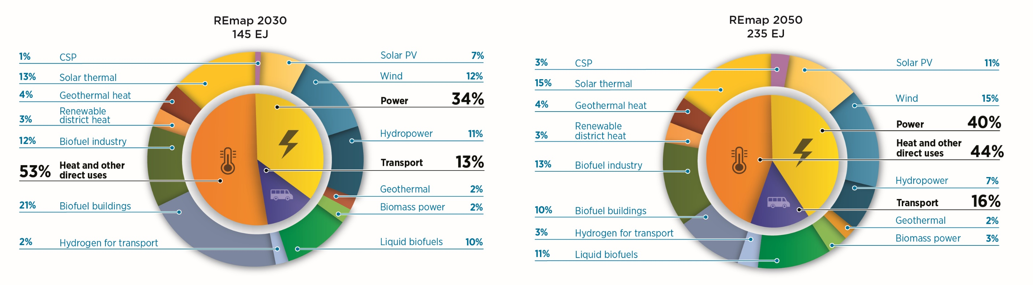
Final renewable energy use by sector and technology in REmap
Under REmap, final renewable energy use is four-times higher in 2050 than it is today.
Power and heat consume about 40% and 44% of the total renewable energy, respectively,
while transport uses about 16%.

Slide 16
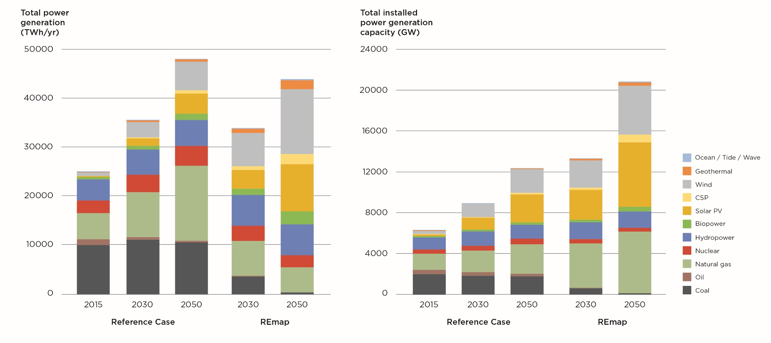
Power generation capacity and total electricity generation
by technology in the Reference Case and REmap
Renewables
80% of generation
Renewables
70% of capacity
The power sector will see the highest share of renewables.
In REmap by 2050, a diverse mix of renewables will provide more than 80% of electricity, with wind and solar providing the largest shares.
Coal and oil in power generation will be eliminated.

Slide 17
The end-use sectors transition: untapped area

Slide 18
Conclusions
Early action is critical in order to limit the planet’s temperature rise to 2ºC and to maximise the benefits of this energy transition, while reducing the risk of stranded assets.
Sectoral approaches must be coupled with systems wide perspectives to address the main challenge of reducing the direct use of fossil fuels in end-use sectors. Deep emission cuts in the power sector are a key opportunity and should be implemented as a priority.
Carbon emissions from energy use need to fall to zero by 2060 and stay at this level thereafter to achieve targets by the end of the century.
Increased investment in innovation needs to start now to allow sufficient time for developing the fundamental new solutions that are needed for multiple sectors and processes, many of which have long investment cycles.
Energy and climate policies must be better integrated.
The energy transition requires the implementation of appropriate economic policies and market structures.

Slide 19




Thank you!
www.irena.org
^{www.twitter.com/irena}
^{www.facebook.com/irena.org}

